Slide 1
DevOps
Aruna Kumbhar

Slide 2
Revise
DevOps
Culture & Collaboration
CI/CD Pipeline
Infrastructure as a Code
Configuration Management
Microservices
Shift-Left Testing
Rollback & Resilience

Slide 3
https://www.youtube.com/watch?v=Awp0iWETRL8

Slide 4
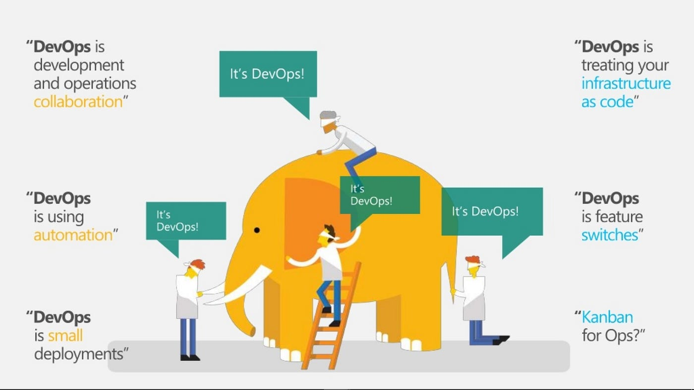

Slide 5
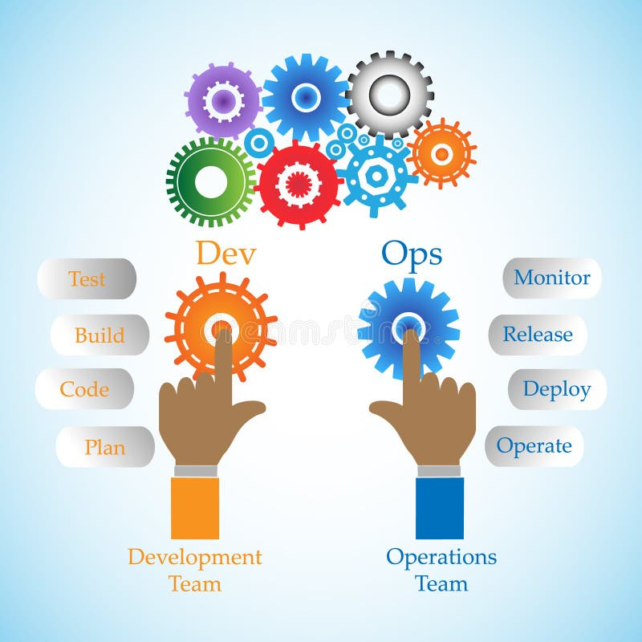
📜 The History of DevOps: From Chaos to Culture
🎬 The Dark Ages (Pre-2000s)
"It works on my machine." — The 5 most expensive words in software history.
Developers wrote code
Operations guarded the production servers
They spoke different languages, sat on different floors, and hated each other
When code broke? Blame flew like arrows.
Developers said "Ops broke my perfect code." Ops said "Dev wrote garbage."
Users just cried

Slide 6
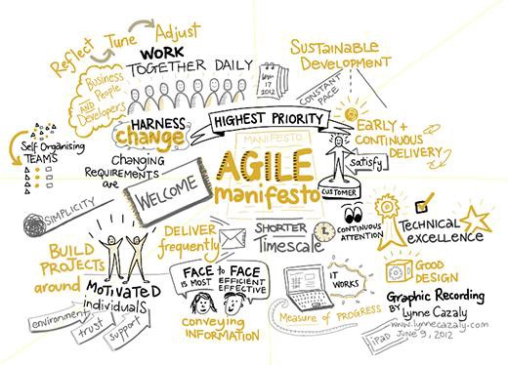
🎬 The Agile Spark (2001)
In 2001, a group of developers wrote the Agile Manifesto:
"Working software over comprehensive documentation.“
Agile sped up development. But here's the catch — Ops couldn't keep up.
It was like building a Ferrari factory... but the delivery trucks were still horse-drawn carts.
The wall between Dev and Ops got taller, not shorter.

Slide 7
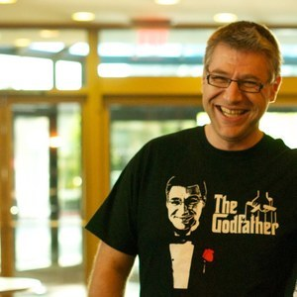
🎬 The Birth of DevOps (2009)
🍺 The Beer That Changed Everything
In June 2009, at a conference in Belgium, two guys named Patrick Debois and Andrew Shafer were frustrated. They wanted a talk about Agile + Operations. Nobody showed up. So they went to a bar instead.
Over beers, they realized: "We're not the only ones who think Dev and Ops should be friends.“
Patrick created a conference called "DevOpsDays" in Ghent, Belgium. He squished "Dev" and "Ops" together like a sandwich. The term "DevOps" was born.
🎯 Fun Fact: Patrick Debois is literally called "The Godfather of DevOps." He didn't invent the practices — he just gave the movement a name and a conference.

Slide 8
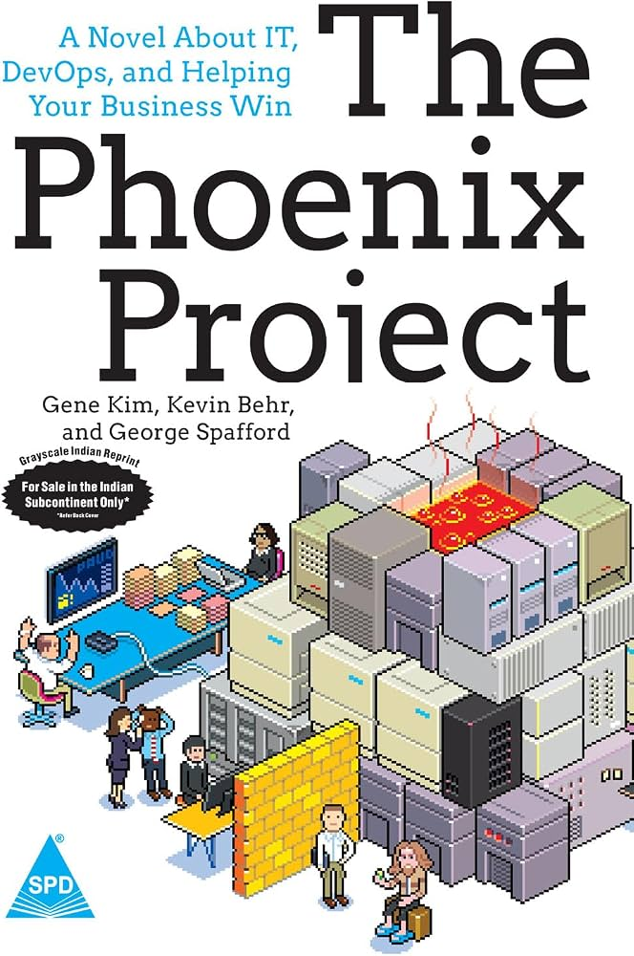
🎬 The Phoenix Rises (2013)
In 2013, three authors — Gene Kim, Kevin Behr, and George Spafford — wrote a novel:
📖 The Phoenix Project
It's a fiction book about an IT manager named Bill trying to save a failing company. It reads like a thriller — but teaches DevOps principles.
"DevOps went from a conference hashtag to a global movement because of a NOVEL.“
It's still the #1 recommended DevOps book.
If you haven't read it, you're missing the origin story.

Slide 9
🎬 The Tool Explosion (2013–2016)
🐳 2013: Docker Arrived
Before Docker, deploying software was like moving houses — you packed everything and prayed it fit. Docker said: "Just bring the whole room.“
Containers made DevOps accessible to mere mortals.
☸️ 2014: Kubernetes Was Born
Google open-sourced their internal "Borg" system. Now even small startups could orchestrate containers like tech giants.
🔄 CI/CD Became Mainstream
Jenkins, GitLab CI, CircleCI, Travis CI — suddenly everyone had a pipeline.

Slide 10
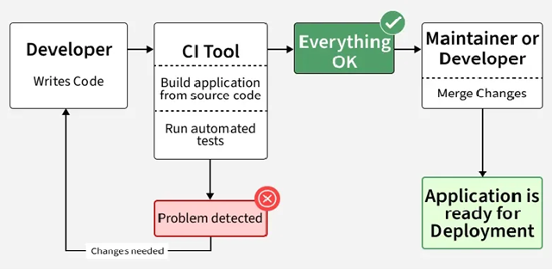

Slide 11
🏆 DevSecOps: The Term is Born (2012–2013)
Development + Security + Operations
Security becomes part of the development and delivery lifecycle
Traditional:
Build house → Move in → Buy lock. 😂
DevSecOps:
Think about security while designing the house.

Slide 12
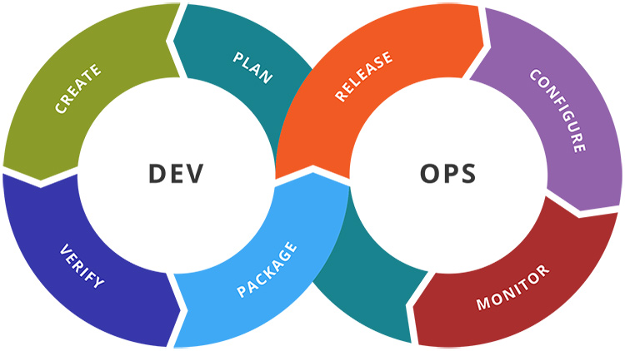
🎬 DevOps Today (2020s–Now)

Slide 13
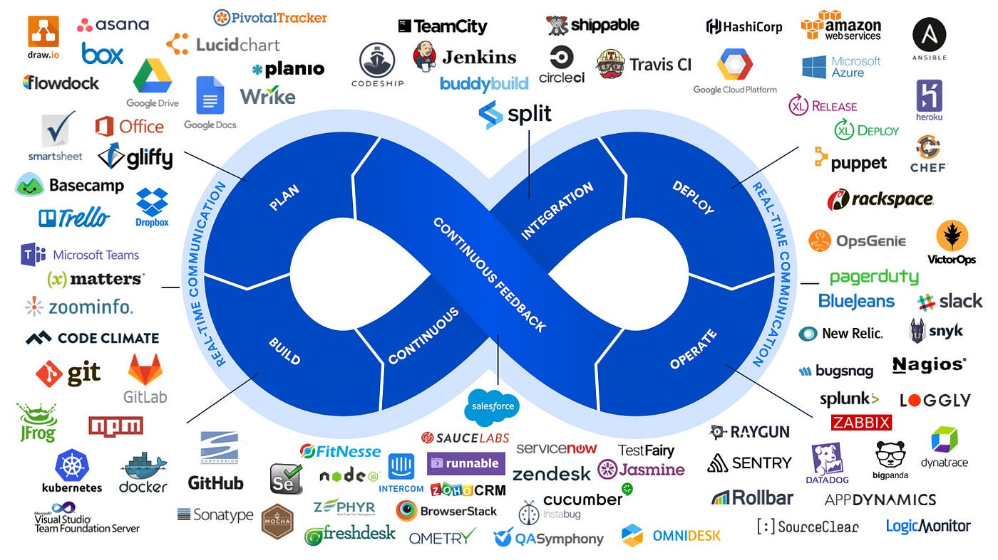

Slide 14
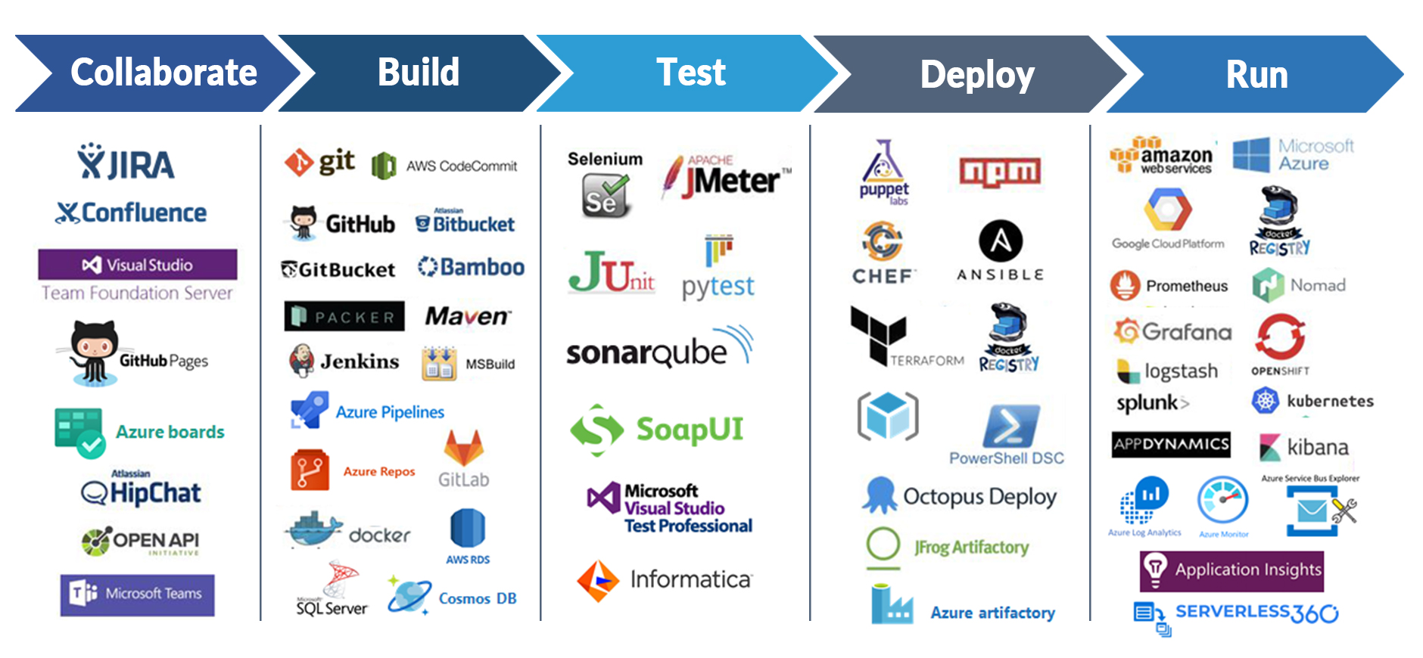

Slide 15
🍕 CI/CD (Continuous Integration / Continuous Deployment)
The Analogy: Making a sandwich at Subway
You tell the Subway guy: "Veggie patty, lettuce, tomato, extra sauce." He builds it in front of you, step by step. If he puts onions and you said no onions, you catch it immediately — not after you've paid and left the store.
That's CI/CD. Every ingredient (code change) is checked instantly.
If it's wrong, you fix it before it reaches your mouth (production).

Slide 16
📦 Container (Docker)
The Analogy: Instant Noodles (Maggi)
The Maggi packet has everything: noodles, tastemaker, oil. You just add hot water. Whether you're in a 5-star hotel or a ₹200 hostel room, it tastes identical because the environment is sealed inside the packet.
A container is a Maggi packet. All ingredients are pre-measured and sealed.
Just add a container runtime (Docker) and hot water (compute), and you get the exact same result — every single time.

Slide 17
☸️ Kubernetes
The Analogy: A wedding caterer managing 500 lunch boxes
You have 500 lunch boxes (containers) to deliver. Some go to Table A, some to Table B. A few get dropped (crash).
Kubernetes is the hyper-organized caterer who:
Notices a dropped box and instantly replaces it
Moves boxes from overcrowded tables to empty ones
Makes sure every guest gets exactly what they ordered
Scales up when 100 uninvited guests show up

Slide 18
📊 Monitoring / Observability
The Analogy: Your mom knowing you're sick before you do
You think you're fine. But your mom notices you didn't touch your food, you're sleeping more, and your phone screen time dropped. She observes symptoms you didn't even know you had.
Monitoring tools are your mom for servers — they know something's wrong before the server itself admits it.

Slide 19
🔵🟢 Blue-Green Deployment
The Analogy: Having two identical outfits
You have two identical blue shirts. You're wearing one (Blue = live production). You spill coffee on it (bug found). Instead of washing it while wearing it (downtime), you just switch to the other identical green shirt (Green = new version).
Users never see you shirtless. Zero downtime. Later, you wash the coffee-stained one at your leisure.

Slide 20
🐤 Canary Deployment
The Analogy: Tasting food before serving guests
You're cooking for 100 people. Before serving everyone, you give a small spoonful to one trusted friend (canary). If they don't die, you serve everyone. If they start coughing, you stop.
You didn't poison 100 people — you poisoned one, caught it early, and fixed the recipe.

Slide 21
⚖️ Load Balancer
The Analogy: A traffic cop at a college canteen
It's lunch hour. Everyone rushes to Counter 1. Counter 1 explodes. Counter 2 is empty, sad, and lonely.
The load balancer is the traffic cop who says: "Hey, Counter 2 exists! Go there!"
It distributes hungry students (requests) evenly across all counters (servers) so no single counter dies of overwork.

Slide 22
🚪 APP Gateway
The Analogy: The receptionist at a hospital
You walk into a hospital. You don't barge into the operation theater.
You go to the receptionist (API Gateway) who:
Checks your ID (authentication)
Asks what you need (routing)
Checks if the doctor is available (rate limiting)
Sends you to the right department
Bills you on the way out
One door. All the security. All the routing. That's an API Gateway.

Slide 23
📎 Artifact
The Analogy: A packed lunch box
You cooked the food (wrote the code). You packed it in a box (built the JAR/Docker image).
That box is the artifact. It's the thing you actually deliver.
You don't deliver the raw ingredients (source code) to the user. You deliver the packed, ready-to-eat lunch box.

Slide 24
🚰 Pipeline
The Analogy: An assembly line at a dosa stall
Batter → Spread on pan → Add filling → Fold → Serve. Each step is automatic. If the batter is bad, the line stops at step 1. If the filling is wrong, it stops at step 3. Nothing reaches the customer unless every step passes.
That's a CI/CD pipeline. Code enters at one end. A working feature exits at the other. Or it gets rejected midway.

Slide 25
🎭 Staging vs. Production
The Analogy: Dress rehearsal vs. Final exam
Staging: The dress rehearsal. You wear the costume, say the lines, check the lights. If you forget your lines, nobody cares. It's fake.
Production: The final exam. Real judges. Real consequences. If you forget your lines here, it's on YouTube forever.
You ALWAYS rehearse in staging before performing in production. Unless you enjoy public humiliation.

Slide 26
💀 Downtime
The Analogy: The canteen running out of samosas
It's 1 PM. 500 hungry students.
The canteen announces: "Samosas are finished. Come back in 30 minutes."
Riots almost happen.
That's downtime. Your service is unavailable. Users are angry. Revenue is zero. And someone's definitely getting fired.

